Slide 1


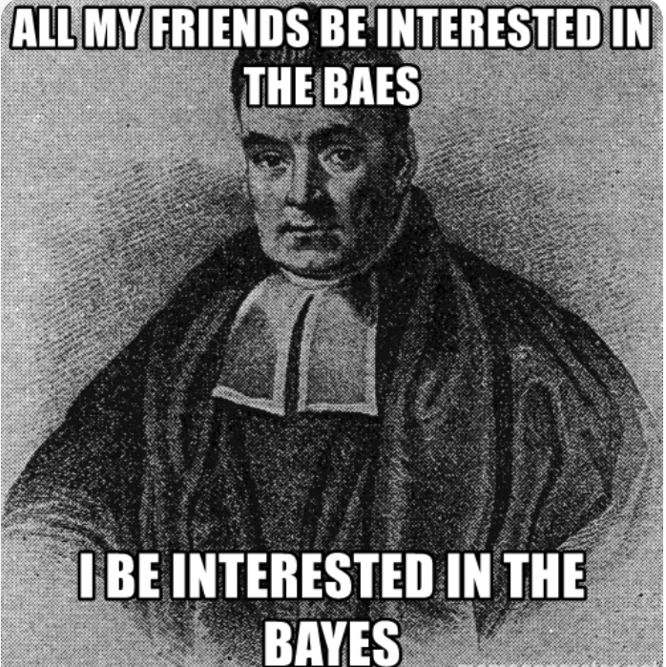
Language Classification using Naïve Bayes
Deac Melinda-Anca
30442

Slide 2
Table of contents
01
02
03
04
05
06
Data preprocessing
Problem
Introduction&
Algorithm
What is the theory behind the Naïve Bayes Classifier
Short description of the problem on-hand
Data preparation steps and model choice
Train
Test
Conclusions
Model training steps
Model testing steps and results
Conclusions drawn

Slide 3


Introduction
The Naive Bayes Classification Method is basically a probabilistic algorithm based on Bayes’ theorem, which is a fundamental theorem in probability theory.
The “naive” part of Naive Bayes comes from the assumption that features used to describe an instance are conditionally independent, given the class label.
The classifier, in a nutshell, predicts the class based on the input features by selecting the class that achieves the highest posterior probability.

Slide 4
Components
P(Class)
P(Class|Feature)
P(Feature|Class)
Prior Probability
Likelihood
Posterior Probability
The probability of each class before considering any features
The probability of observing a particular feature given a class
The probability of a class given the observed features, calculated using Bayes' theorem.

Slide 5

Algorithm
Naive Bayes assumes that the features are conditionally independent given the class. This means that the presence or absence of a particular feature does not affect the presence or absence of any other feature.
Compute the priors for each class (how likely are you to obtain that class, without taking into account the features). Computed as 1/total_number_of_classes.
Count how many times each feature appears per class, then obtain the likelihood of that feature to be in the class by dividing this number by the total number of appearances of all features for the current class.
Having the priors and the likelihoods, for any new input, compute the posterior probabilities for each class using bayes formula, and provide as class result the one with the highest posterior probability.

Slide 6

Problem
Given a dataset containing English and Dutch phrases, train a classification model using Naïve Bayes so that, when given a new phrase, to be able to tell if it is in English or in Dutch.
en|maple heightslake desire is a censusdesignated place cdp in king county washington united states at the 2010 census the population was 3152based on per capita income one of the more
nl|saranganotrichia kaosoidao is een schietmot uit de familie hydroptilidae de soort komt voor in het oriëntaals gebied

Slide 7
Data Preprocessing
Given two files: for training and for testing, first take the training file.
readTextFile takes care of opening the file and separating the labels from the phrases:
char* label = strtok(line, "|");
char* text = line + strlen(label) + 1;
text[strcspn(text, "\n")] = '\0';
tempData.push_back(text);
tempLabels.push_back(label);
toLower(tempData[count]);

Slide 8
Data Preprocessing
Also, in this step the letter pairs must be generated to be able to initialize the features matrix X. The array contains all combinations of letter+letter and letter+space:
std::vector<std::string> initializeLetterPairs()
{
std::vector<std::string> letterPairs;
for (char c1 = 'a'; c1 <= 'z'; c1++)
{
for (char c2 = 'a'; c2 <= 'z'; c2++)
{
std::string pair = std::string(1, c1) + std::string(1, c2);
letterPairs.push_back(pair);
}
letterPairs.push_back(std::string(1, c1) + " ");
letterPairs.push_back(" " + std::string(1, c1));
}
letterPairs.push_back(" ");
return letterPairs;
}

Slide 9
Training
To train the model means to obtain the likelihood and the priors from the training file. After opening the file, there should be:
std::vector<std::string> data containing the phrases (one phrase per index)
std::vector<std::string> labels containing on each row the class of the associated phrase from the data array
int numSamples containing the total number of training phrases
std::vector<std::string> letterPairs containing all combinations of letters and space
To compute the feature matrix, each row from data is taken 2 characters by two. If the pair contains valid values (letters or space), then the corresponding slot from the features matrix gets incremented.
for (size_t i = 0; i < str.length() - 1; i++){
std::string pair = str.substr(i, 2);
auto it = std::find(letterPairs.begin(), letterPairs.end(), pair);
if (it != letterPairs.end()){
int index = std::distance(letterPairs.begin(), it);
X(X_row, index)++;
}
}

Slide 10
Training
The prior for each class is computed by dividing the total number of samples from the class by the total number of samples:
priors(0, 0) = (1.0 * nrOfEnglishSamples) / numSamples;
priors(1, 0) = (1.0 * nrOfDutchSamples) / numSamples;
To compute the likelihoods, for each class, the number of appearances of a certain feature is counted, then, the likelihood for the given class to have the feature is obtained:
for (int feat = 0; feat < d; feat++){
int nr = 0;
for (int k = 0; k < X.rows; k++) {
if (X(k, feat) > THRESHOLD && y(k, 0) == 0) {
nr++;
}
}
likelihood(0, feat) = (nr + 1.0) / static_cast<double>(nrOfEnglishSamples + C);
}

Slide 11
Testing
The testing file is opened and parsed again, like before, to obtain the phrases and their associated classes.
Now, to test the prediction of the model, for each input phrase, the classifyBayes function is called being given the phrase, the computed priors and likelihoods and the letter pairs.
For the phrase given the feature matrix (the feature row actually) is computed, incrementing the index of each found pair of letters.
Afterwards, the posterior probabilities for each class are computed using the prior for the class and the sum of likelihoods for the given class:
Mat_<double> priorForClass(priors.rows, 1);
for (int c = 0; c < priors.rows; c++) {
priorForClass(c, 0) = 0;
double sumOfLikelihoods = 0;
for (int feat = 0; feat < text_X.cols; feat++) {
if (text_X(0, feat) > THRESHOLD){
sumOfLikelihoods += log(likelihood(c, feat));
}
else{
sumOfLikelihoods += log(1 - likelihood(c, feat));
}
}
priorForClass(c, 0) = log(priors(c, 0)) + sumOfLikelihoods;
}

Slide 12
Testing
After computing the posterior probabilities, the class that has the highest posterior probability is chosen as predicted class
int maxClass = 0;
double maxVal = -INFINITY;
for (int i = 0; i < priors.rows; i++)
{
if (priorForClass(i, 0) > maxVal)
{
maxVal = priorForClass(i, 0);
maxClass = i;
}
}
return maxClass;

Slide 13
Results
The results are analyzed with the confusion matrix, presenting

